Slide 1
GreenBay P&DT S/W Infrastructure Landscape
Internet
IBM Cloud
Mobile App
Backend/Admin Server
Front Server
iOS Android
GreenBay App UI
Admin View Pages
UI Libs
API Routes
View Pages
React-Native
Admin Routes
ReactJS + Webpack
APIs
Core
Utils
Linux OS(IBM Cloud)
Express
Password-jwt
Sequalize
Other
libs
DB Server
Payment Service
NodeJS
DB2
Skrill/Paypal/…
Linux OS(IBM Cloud)
Linux OS(IBM Cloud)

Slide 2
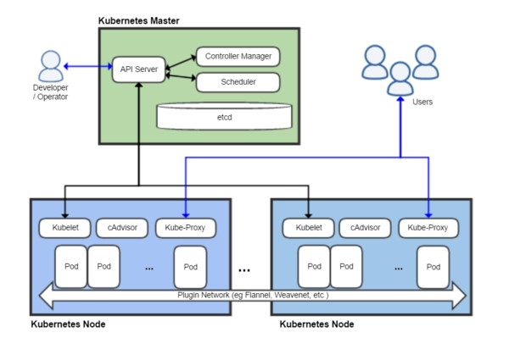
GreenBay P&DT S/W Architecture Components

Slide 3
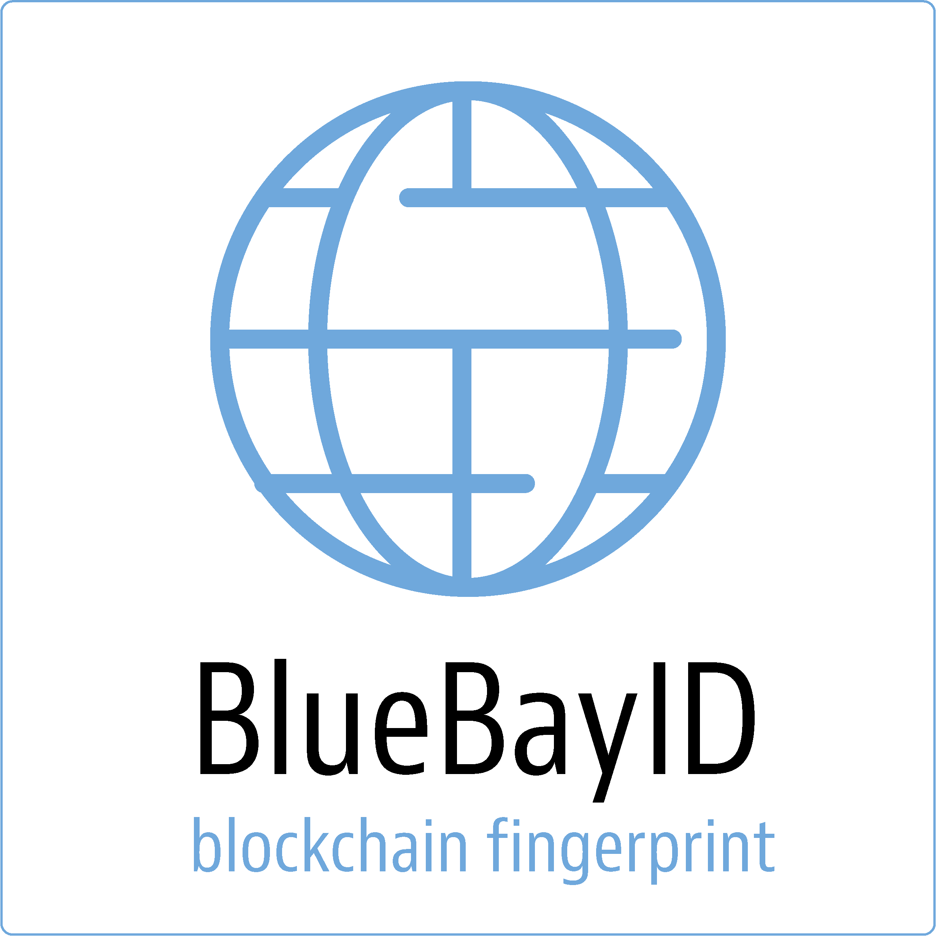
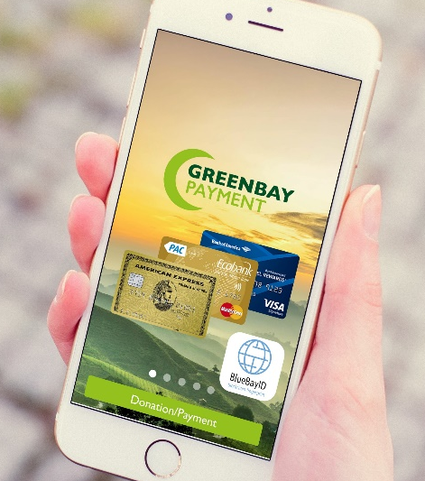
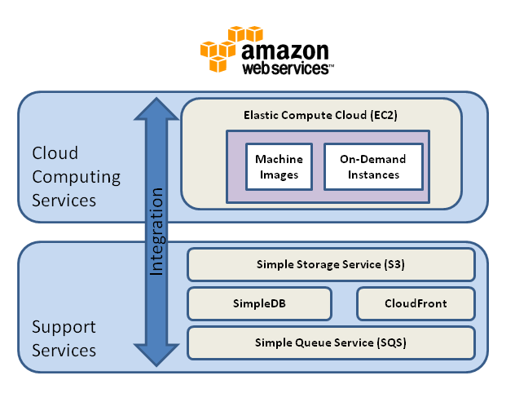
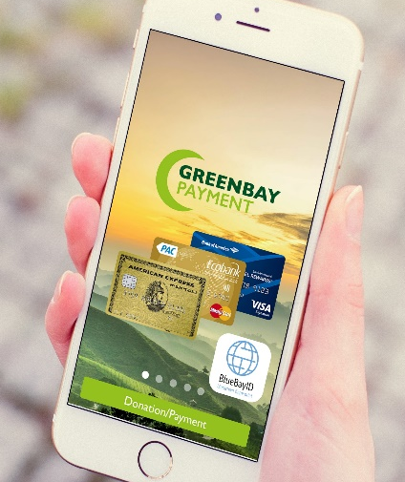


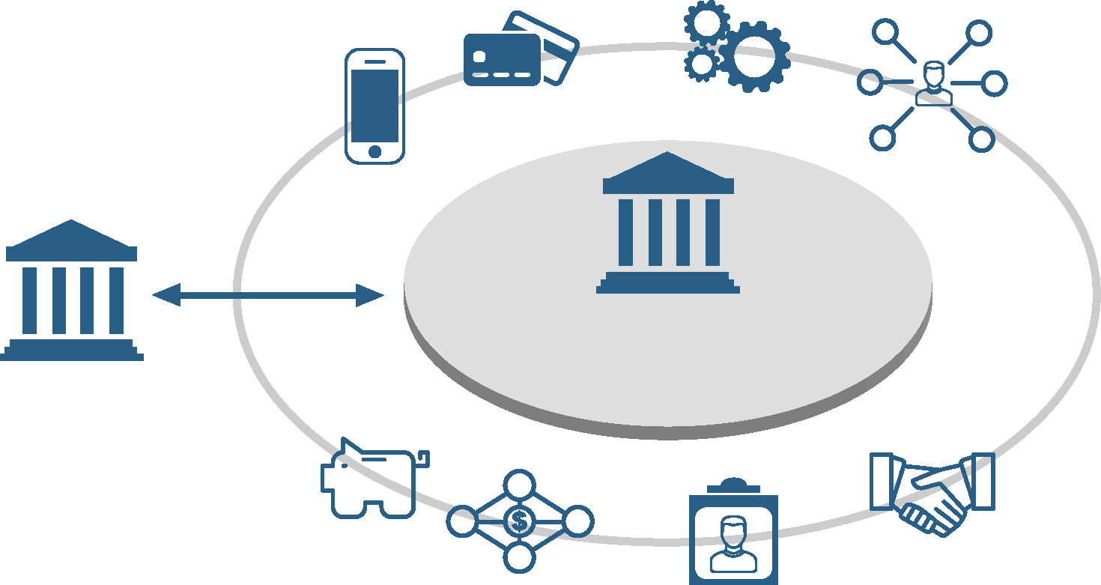
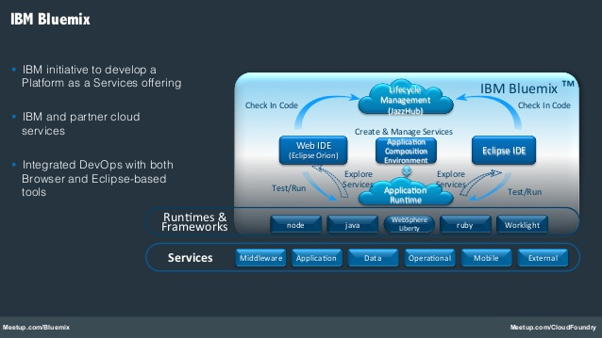
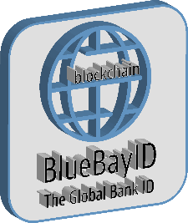

.
GreenBay P&DT S/W Processing Flow
App Storage
App Storage
Public key Private Key
Sending and Receiving Public Key create a private key in the app
Public key Private Key
White Label or GreenBay e-Wallet Sending
White Label or GreenBay e-Wallet Sending
Web Storage
Public key Private Key
White Label e-Wallet Receiving
IBM Bluemix
Blockchain
350 €
BlueBayID Blockchain
Global Bank ID based on Blockchain Technology Virtual Mobile ID, Fingerprints
From 2018 PSD2 & Open Banking PSD2 Exchange API
The global BankID interoperability generic API and for Open Bank Compliance integration
Private Key
Public Key
Blockchain Hashtag Mobile UUID
Ledger transactions * millions
SEB
Nordea

Slide 4
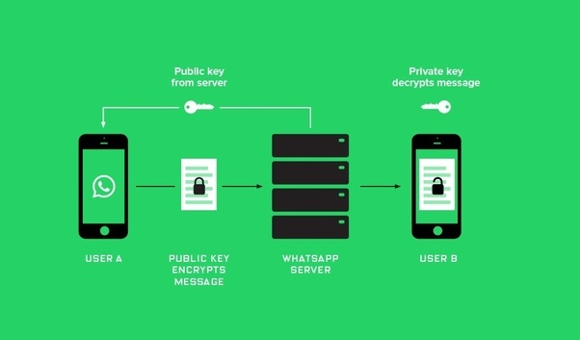
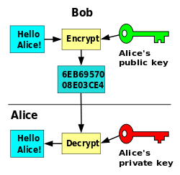
GreenBay P&DT S/W Key Functionality
Public Key and Private Key connected to BluebayID and Blockchain
Keychain K = Device UUID + time
A = UUID from server
Fetch device from database by = A
Private Key
Public Key
Blockchain Hashtag Mobile UUID
Ledger transactions * millions
Time = Current Client Time Id = A OS = IOS 4.0 MPC Version = 1.1 Device= Apple, Iphone 4 Hash=#1234

Slide 5
